Slide 1
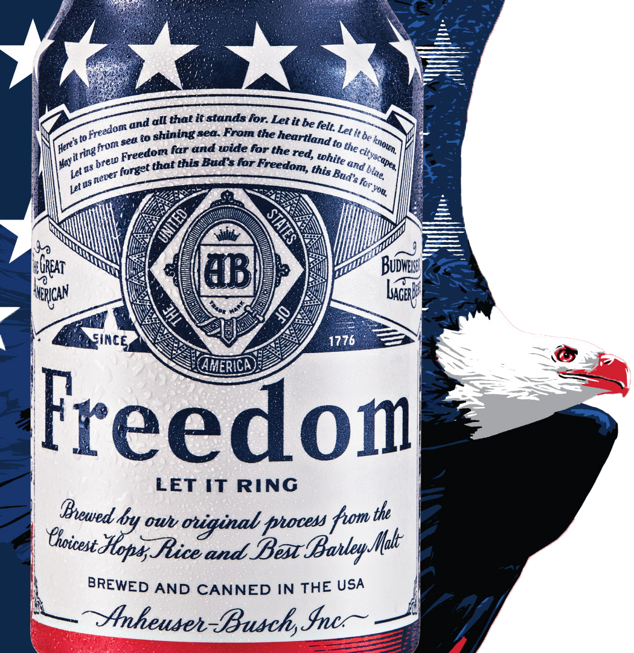

Budweiser:
“The Beers Dataset”
EXPLORATORY DATA ANALYSIS
ADJ Analytics
Arsalan Chandwani, Donald Anderson, & Junhoi Kim

Slide 2

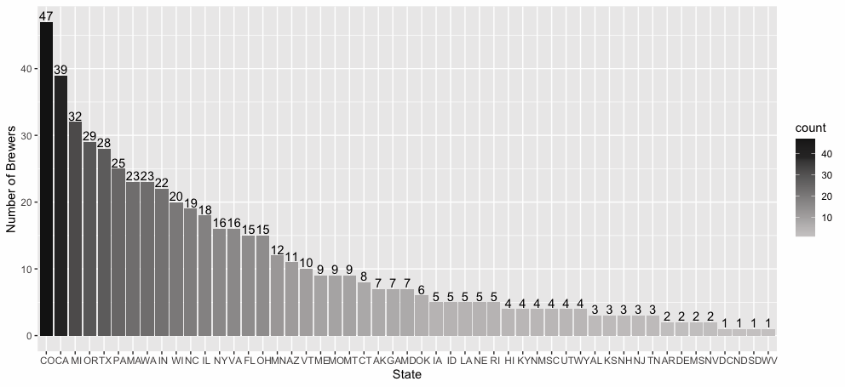
How many Breweries in each State?

Slide 3
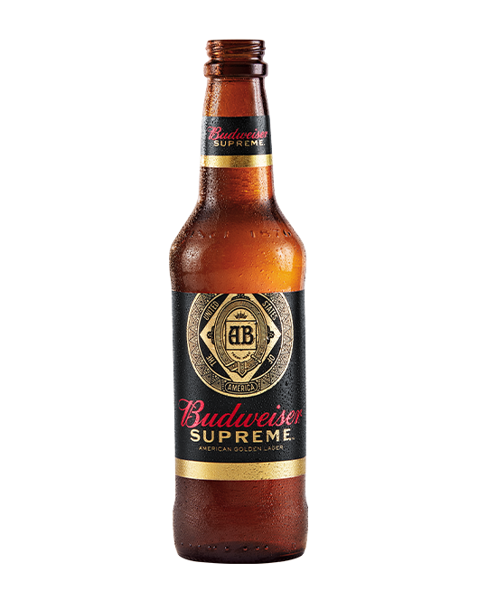
Other Exploratory Data Analysis
Discovering missing values
Our Data Scientists identified 3% of Alcohol By Volume (ABV) of the beer data points that are missing (62 data points)
We also identified 42% of International Bitterness Units (IBU) of the beer data points are missing (1,005 data points)
Handling missing values
To deal with missing values in ABV and IBU variables we used a linear regression model to predict the missing data. There rows of data removed from the data set in cases where the values were not predictable (i.e. instances where both ABV an IBU were missing).
Highest ABV
Without removal of any missing values in ABV or IBU
With removal of all missing values in ABV or IBU
Highest IBU
Regardless of missing values, Oregon has beer with the highest IBU
State | Highest ABV | Number of Beers
Colorado | 0.128 | 250
State | Highest ABV | Number of Beers
California | 0.099 | 135
State | Highest IBU | Number of Beers
Oregon | 138 | 87

Slide 4
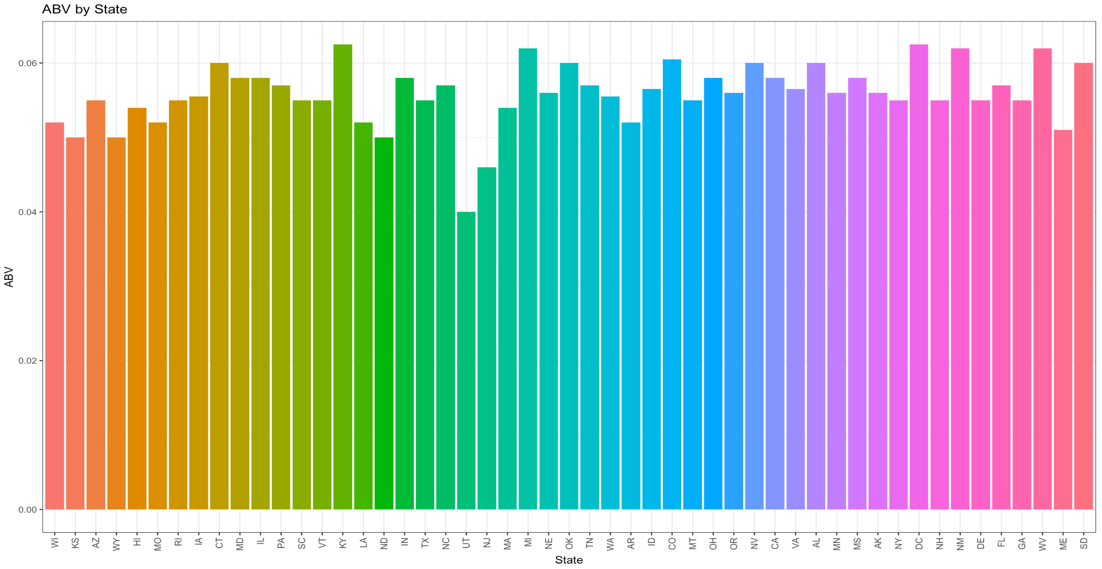
ABV by State
Bar chart of the median Alcohol Content by Volume (ABV) of the beer per state.

Slide 5
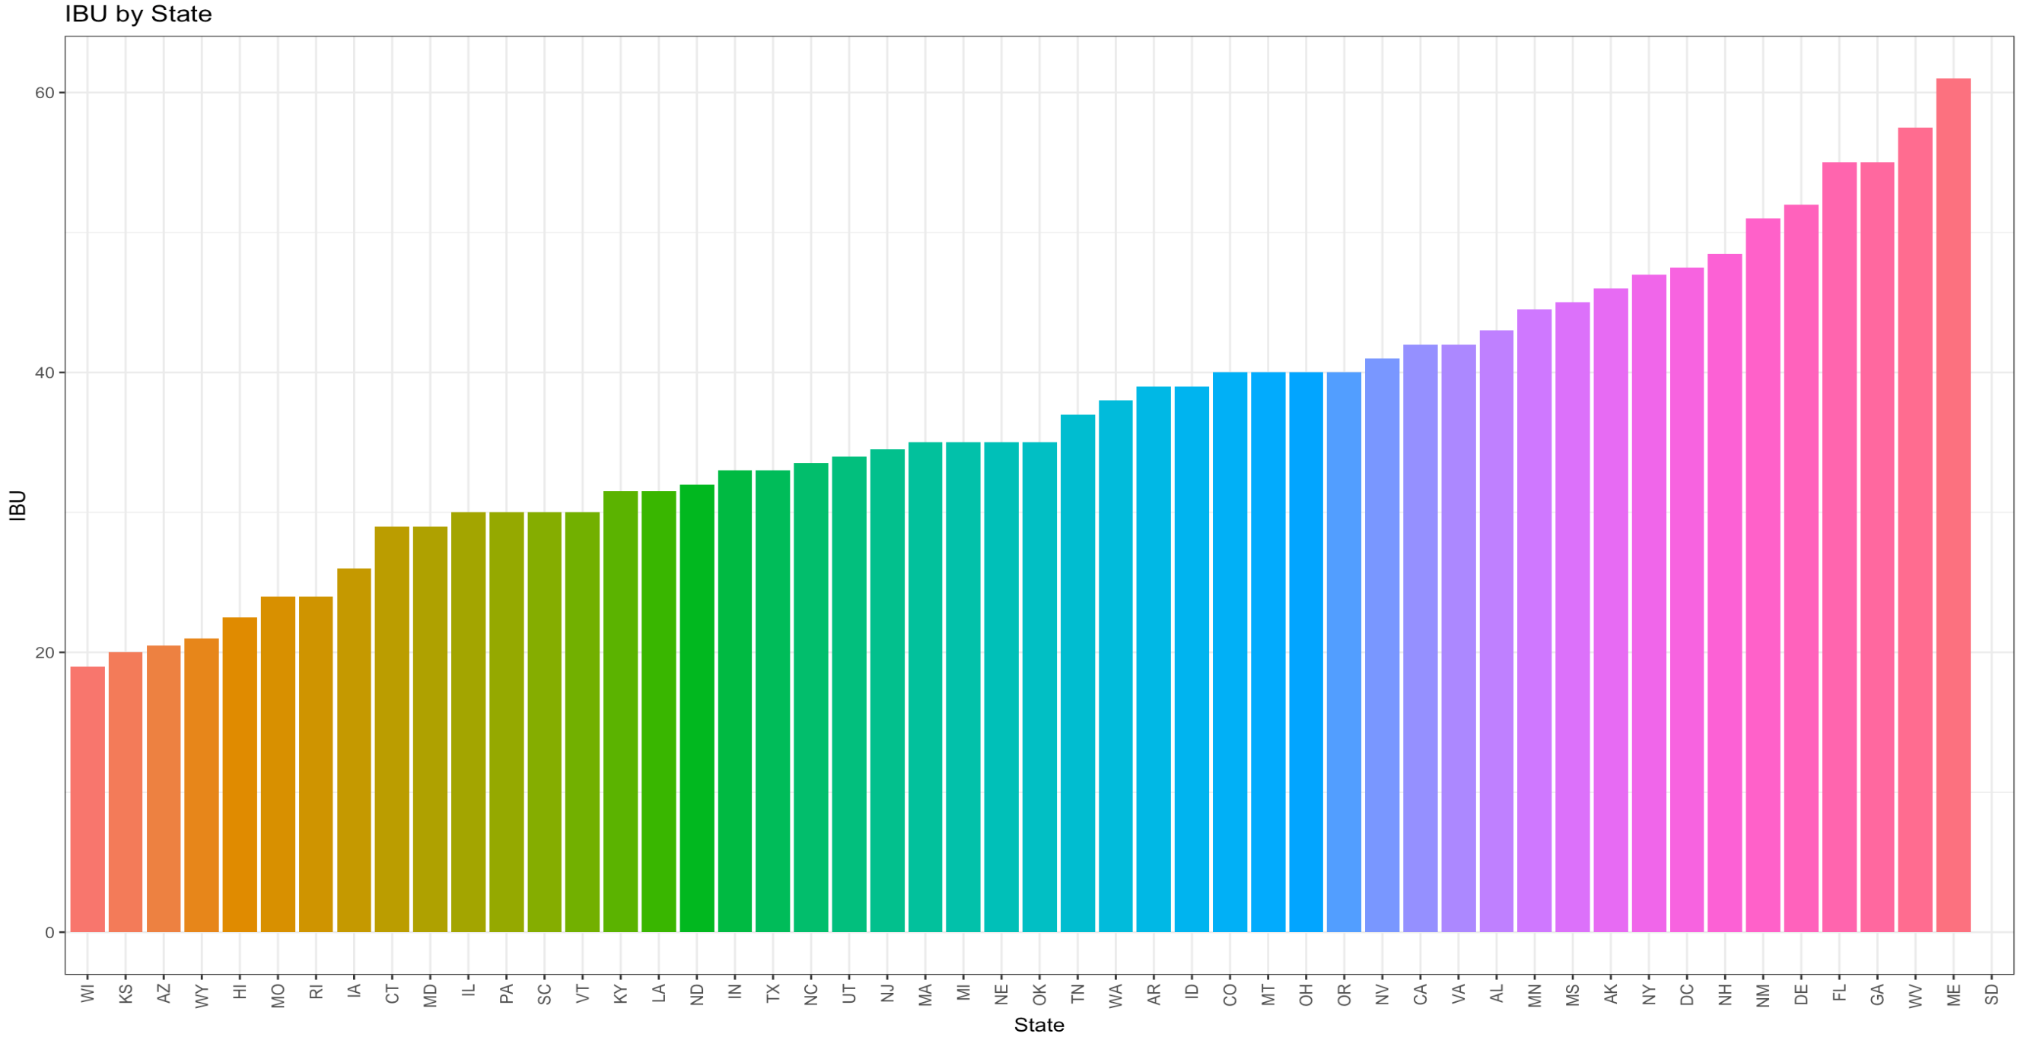
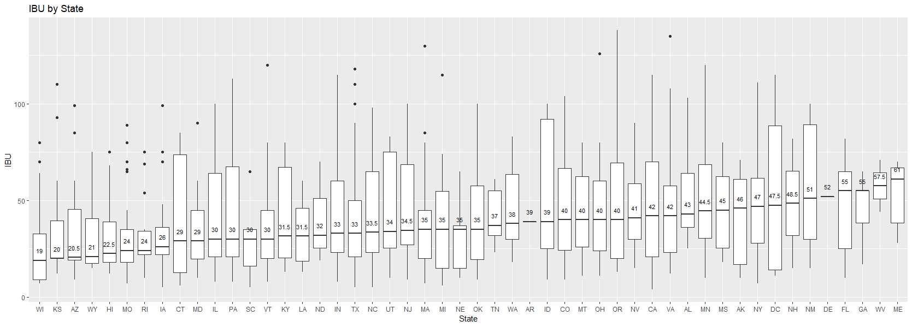
IBU by State
Bar chart of the median International Bitterness Units (IBU) of the beer per state.
*Note: 1 row containing missing data was removed.

Slide 6
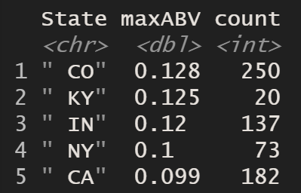
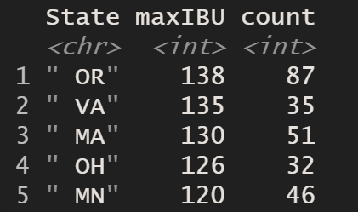
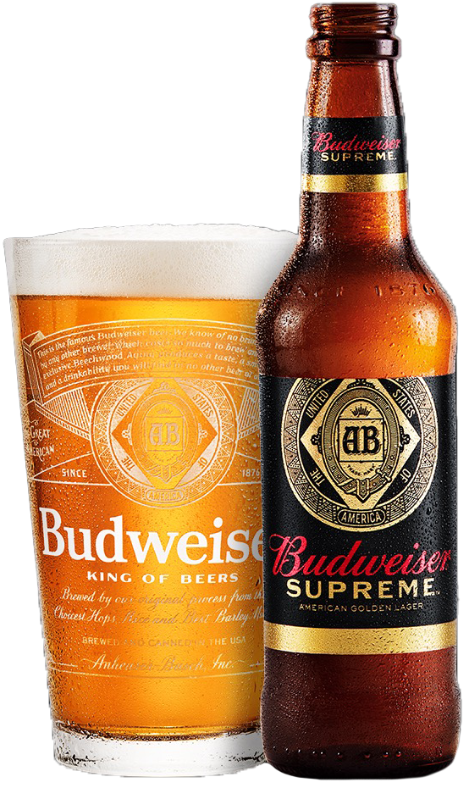
Max ABV and IBU
 | State <chr> | maxABV <dbl> | count <int>
1 | “ CO” | 0.128 | 250
2 | “ KY” | 0.125 | 20
3 | “ IN” | 0.12 | 137
4 | “ NY” | 0.1 | 73
5 | “ CA” | 0.099 | 182
 | State <chr> | max IBU <dbl> | count <int>
1 | “ OR” | 138 | 87
2 | “ VA” | 135 | 35
3 | “ MA” | 130 | 51
4 | “ OH” | 126 | 32
5 | “ MN” | 120 | 46

Slide 7
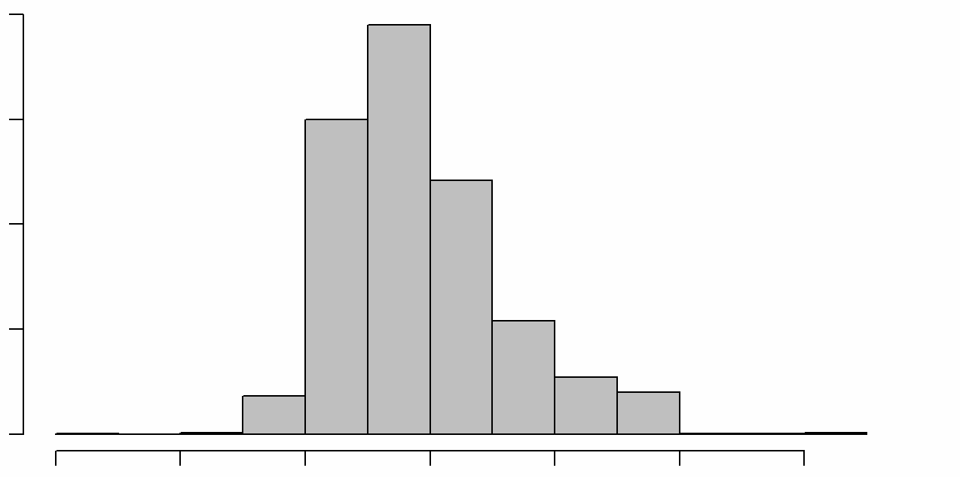
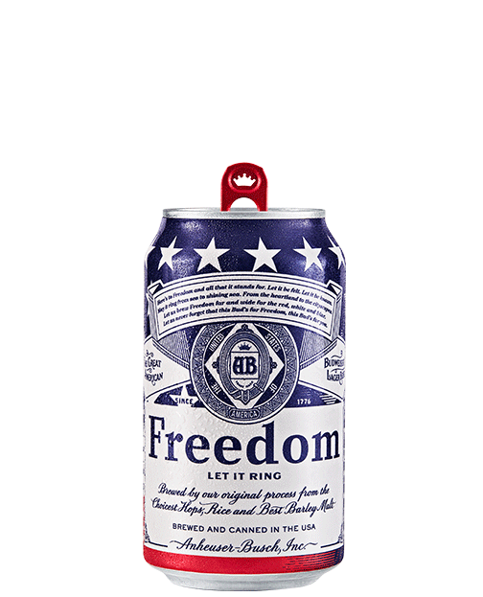
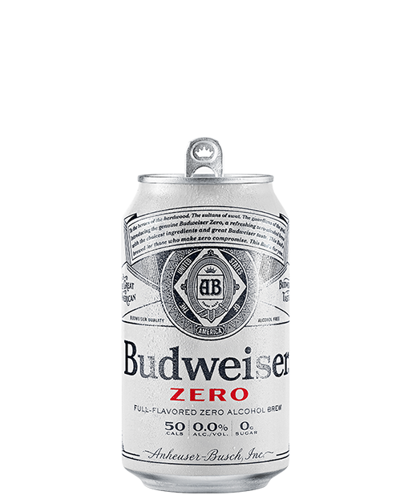
Total ABV statistics
Alcohol by volume of the beer has a mean of 0.06 with a standard deviation of 0.01. The histogram shows that the data is slightly skewed to the right, or more specifically the data is positively skewed.
800
600
Frequency
400
200
0
0.00
0.02
0.04
0.06
0.08
0.10
0.12
ABV

Slide 8
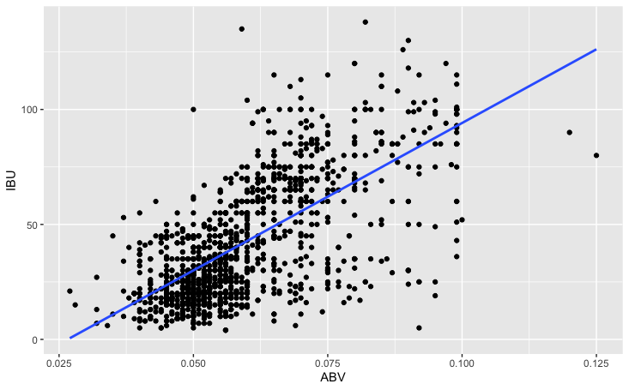
Relationship between ABV and IBU
*Missing values (i.e. NAs) were removed from ABV and IBU
Slope*100 | 0.6706
R-Square | 0.4493
P-value | < 2.2e-16
The scatter plot above shows a strong positive linear relationship between ABV and IBU in beer. This means that as Alcohol by Volume of the beer (ABV) increases, there tends to be an increase in International Bitterness Units (IBU) as well. The two values tend to increase together.

Slide 9
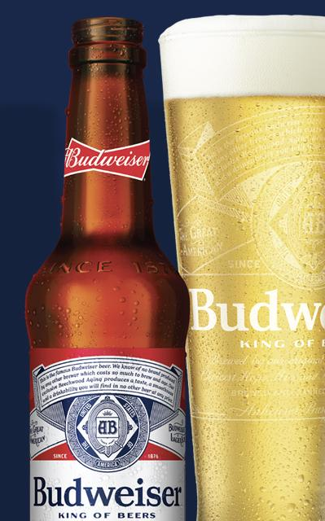
The End
Any Questions?

Slide 10
Appendix
View Presentation on YouTube
Review EDA files here.

